Slide 1
Micro Aneurysms detection using Deep Learning
Team 8
Sadida
Disha Shah
Jesmiteja

Slide 2
Background
Diabetic retinopathy, also known as diabetic eye disease, is a medical condition in which damage occurs to the retina due to diabetes and is a leading cause of blindness.
The Longer a person has diabetes, higher the chance of developing Diabetic retinopathy
This is when high blood sugar levels cause damage to blood vessels in the retina. These blood vessels can swell or they can close, stopping blood from passing through.
MicroAneurysms are the earliest clinically visible changes of diabetic retinopathy. They are localised capillary dilatations which are usually saccular (round).
The only way to detect this problem is by fundus(the part of the eyeball opposite the pupil) photography, in which Micro Aneurysms (microscopic blood-filled bulges in the artery walls) can be seen.

Slide 3
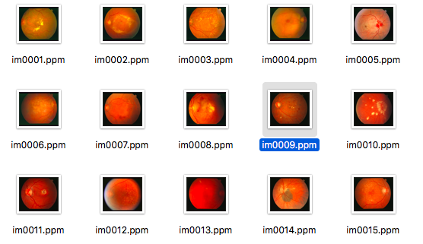
Fundus images

Slide 4
Problem Description
Detection of Micro Aneurysms is a difficult task as they are very small.
Blood vessels and background may have similar intensity values which tends to cause false positive.
Fundus images have large variations in color, contrast and brightness.

Slide 5
Proposed Solution (Deep Learning model) Using MATLAB.
There are many approaches for the detection of the Micro Aneurysms .
A convolutional neural network (CNN, or ConvNet) is a class of deep, feed-forward artificial neural networks that has successfully been applied to analyzing visual imagery .
We have used our own custom convolutional model for the classification task

Slide 6
Proposed Solution (Deep Learning model)Using MATLAB.
Why Pre Trained model?
Fine tuning on a model with transferred learning is easy.
Transfer of newly learned features to your dataset is possible even if the size is small.
The accuracy of a trained model is definitely higher than a fresh model.

Slide 7
Dataset
FIRE: Fundus Image Registration Dataset(129 retinal images)
RITE: Retinal Images vessel Tree Extraction(40 sets of images)
STARE: Structured Analysis of the Retina
DIARETDB: 89 images
We are using the DIARETED dataset for the MA detection.

Slide 8
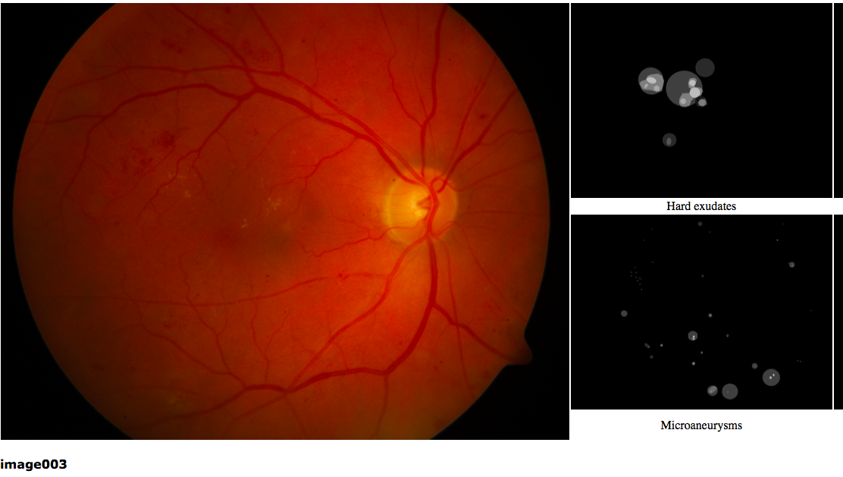

Slide 9
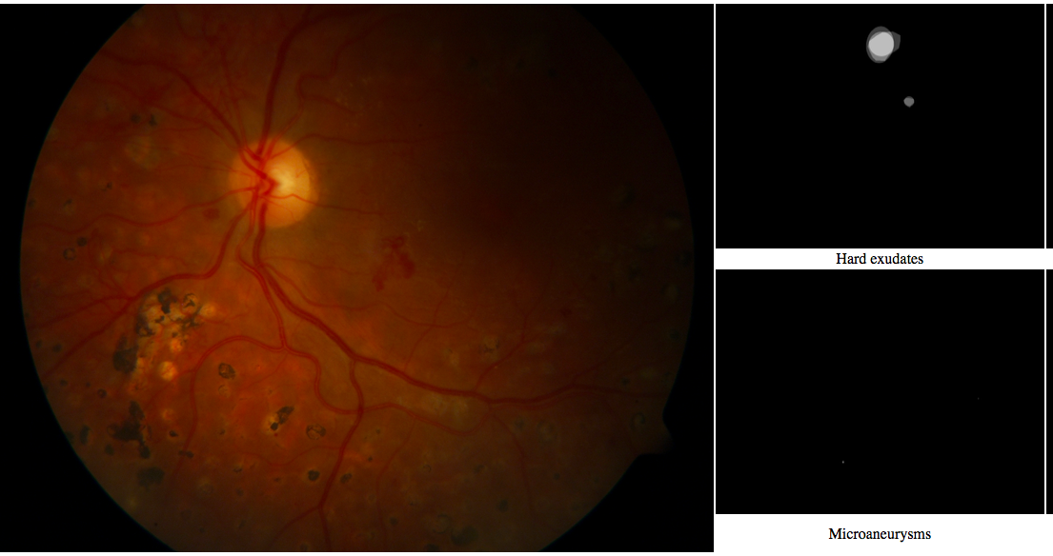

Slide 10
Generating the patches and Training
We divide image into the patches of size 28*28pixels to feed to our custom CNN model .
There are 221 MA patches and they are augmented (using rotation and reflection ) to increase the patches to 1000 patches.
We have feed the CNN with train data consisting of 1000 MA(Augmented) Patches and 1000 Non-MA patches.(50% from each class)
We have used stochastic gradient descent to optimize weights and learning rate 0.0001 and performed 100 epochs to optimize loss.

Slide 11
Testing
We have conducted testing on 44 images 22 MA patches 22 Non-MA patches.

Slide 12
Example of the MA
extracting MA coordinates from coordinate08.txt&#39;coordinate08.txt&#39;
MA x coordinate 1= 870.000000
MA y coordinate 1= 851.000000
MA COORDINATES NOT FOUND FLAG: 0................Generating Non MA patches for EyeImage:8Saving cropped non MA patches in MA Project/NonMApatches folder................

Slide 13
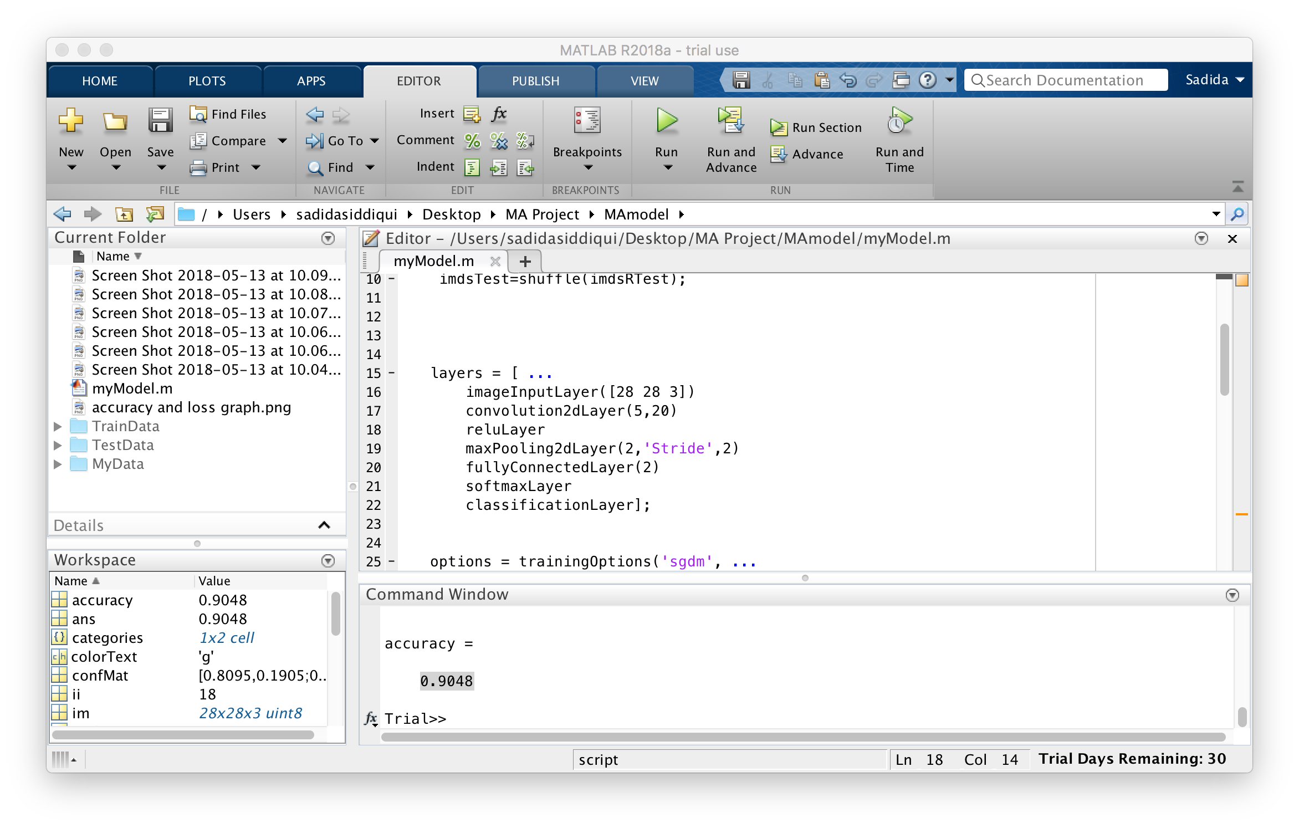
Our custom CNN model Layers

Slide 14
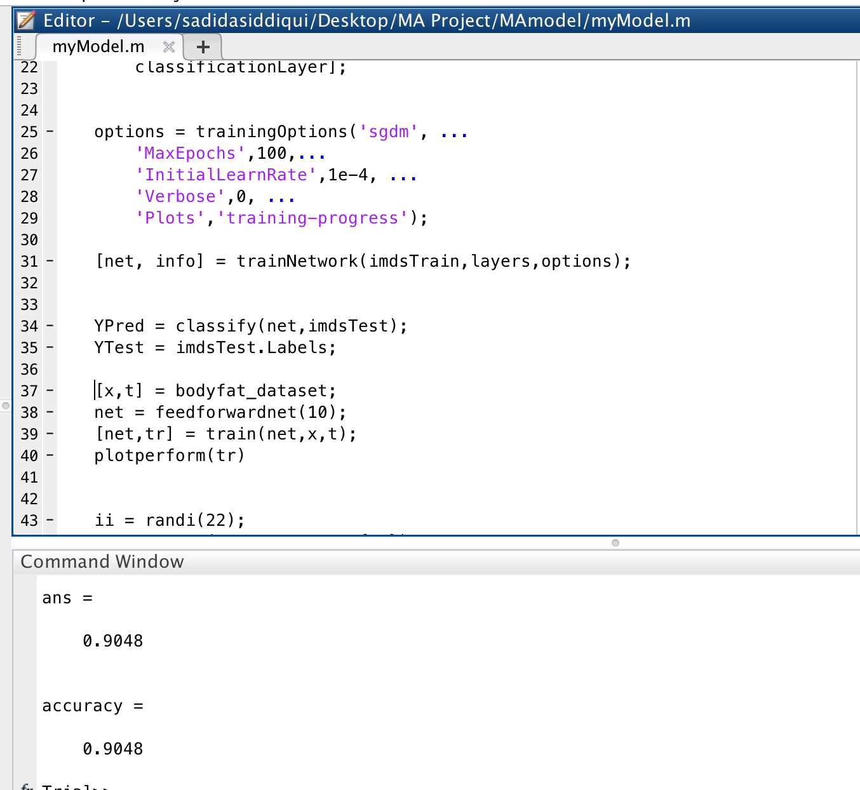
Our CNN model Hyperparameters

Slide 15
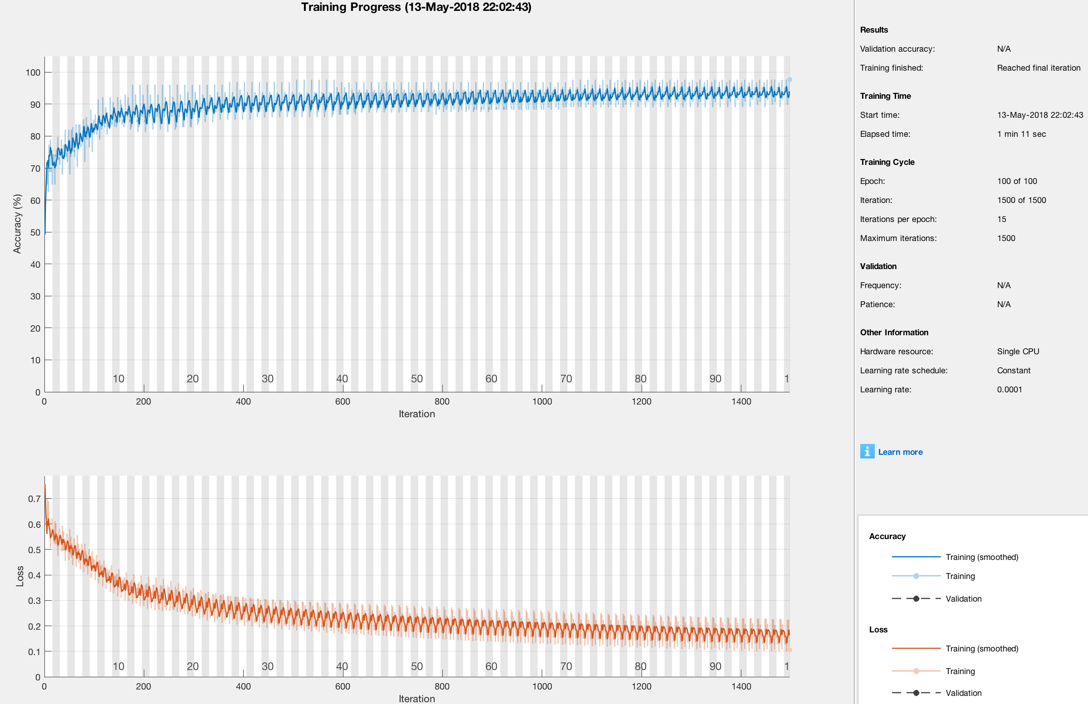
Accuracy and loss curve:

Slide 16
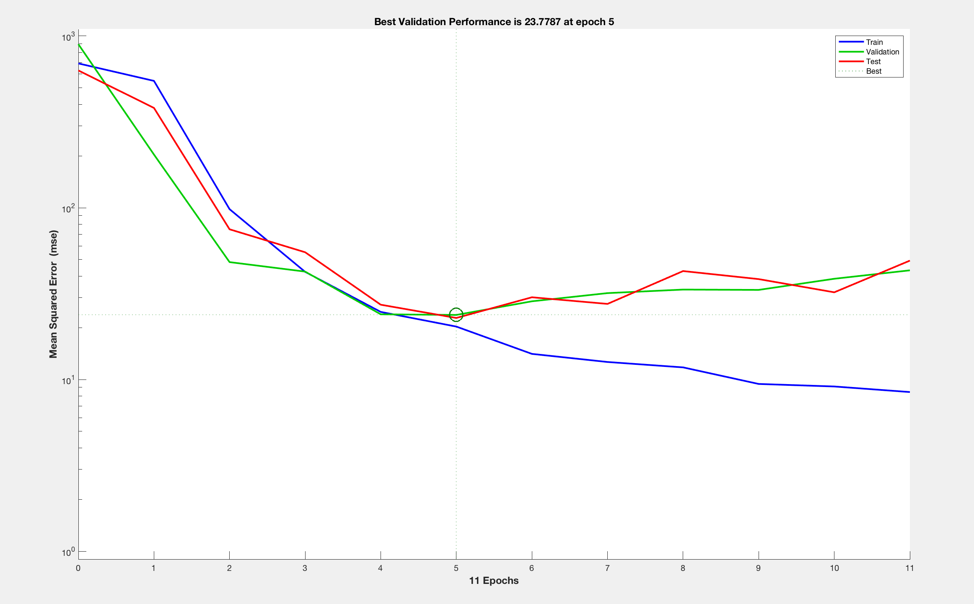
Validation(Reduction in MSE per epoch):

Slide 17
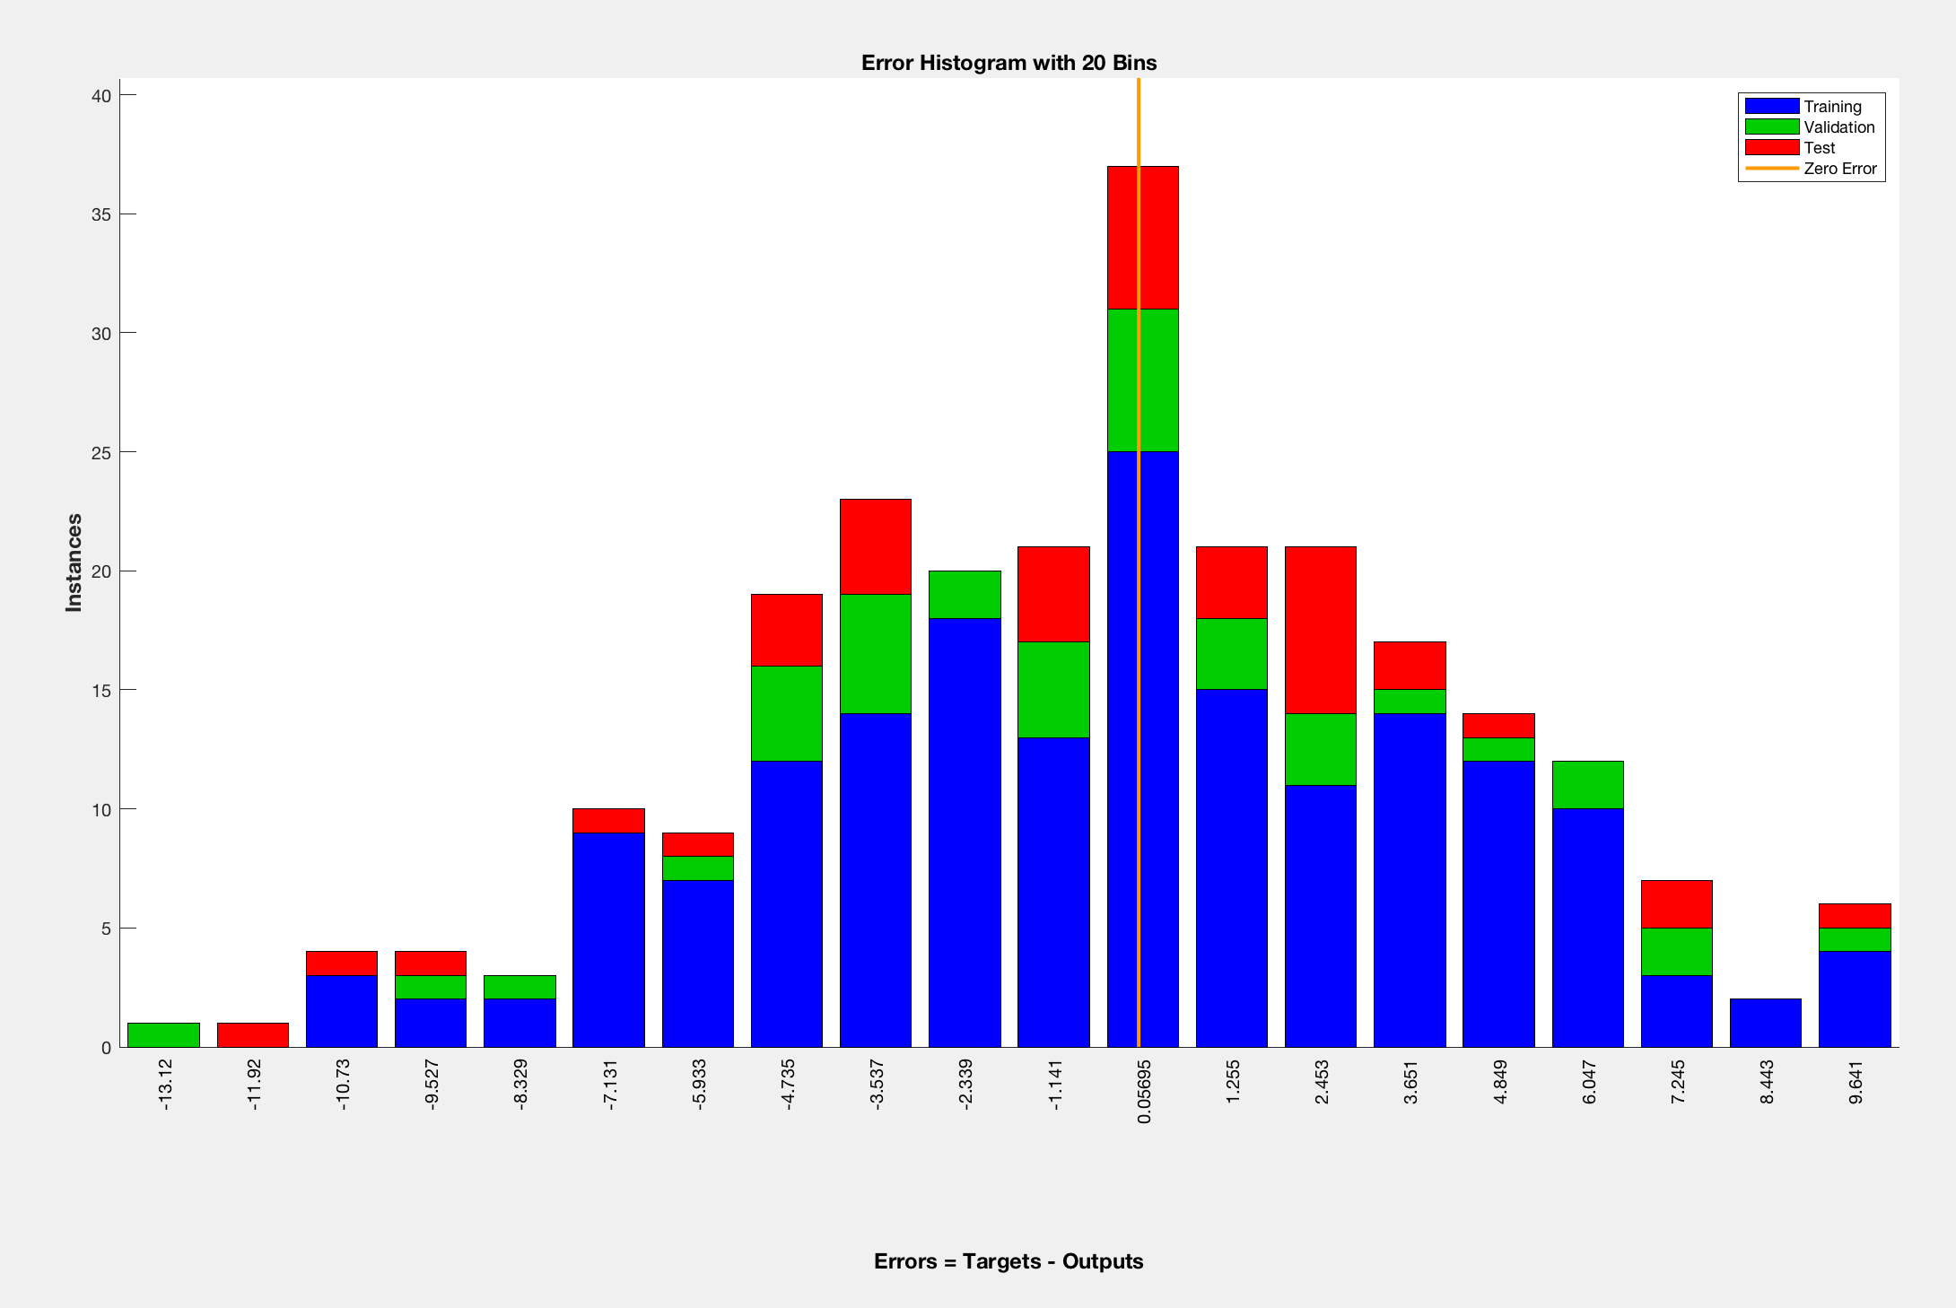
Histogram of testing, training and validation

Slide 18
Thank you !!

